Slide 1
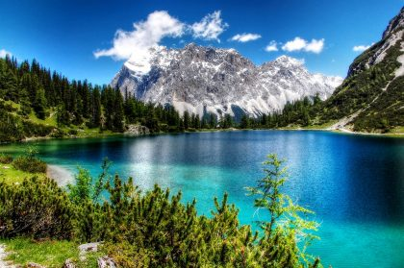
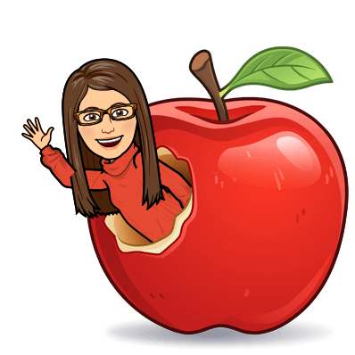
German Classes offered at Perry
Myths and Facts
Willkommen to German!
Culture
About the Teacher
Notes:
https://germanculture.com.ua/travel-to-germany/the-bavarian-alps/ background
https://www.aatg.org/page/GermanIsMyFuture

Slide 2
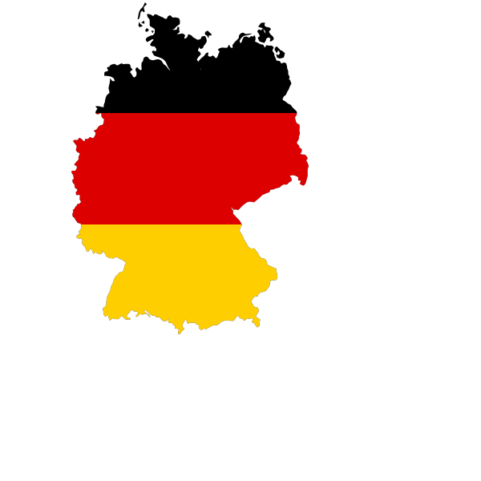
Deutsch bei Perry
Click Here to Return to
Main Menu!
Perry offers four levels of German classes
German I - intro to the German language and culture
German II - continuance of the German language and culture
Honors German III - can be taken for Dual Credit through Chandler Gilbert Community College
AP German IV - can be take for Dual Credit and/or the AP test

Slide 3
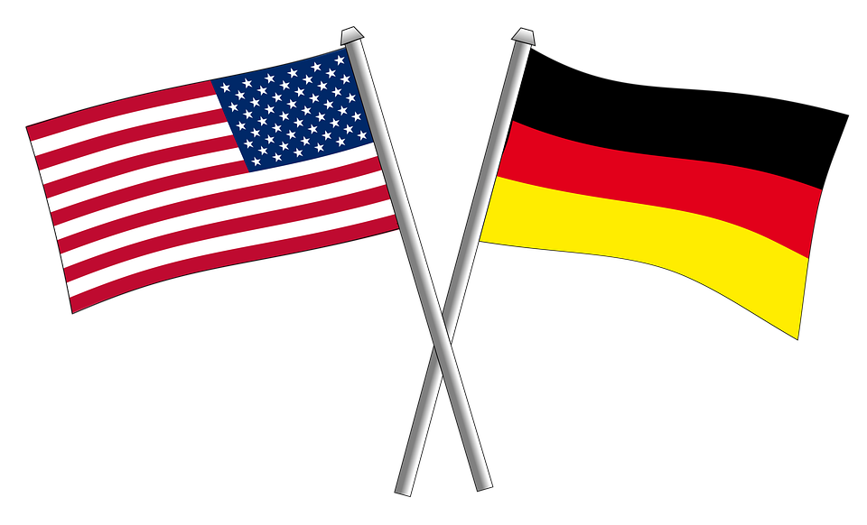

Ich heiße Frau Sandra Zemaitis
Click Here to Return to
Main Menu!
German at Perry is filled with learning the German language, the culture, and interesting facts. We do a variety of activities in class to accomplish these goals:
Speaking, Writing, Reading, Listening, and Playing

Slide 4
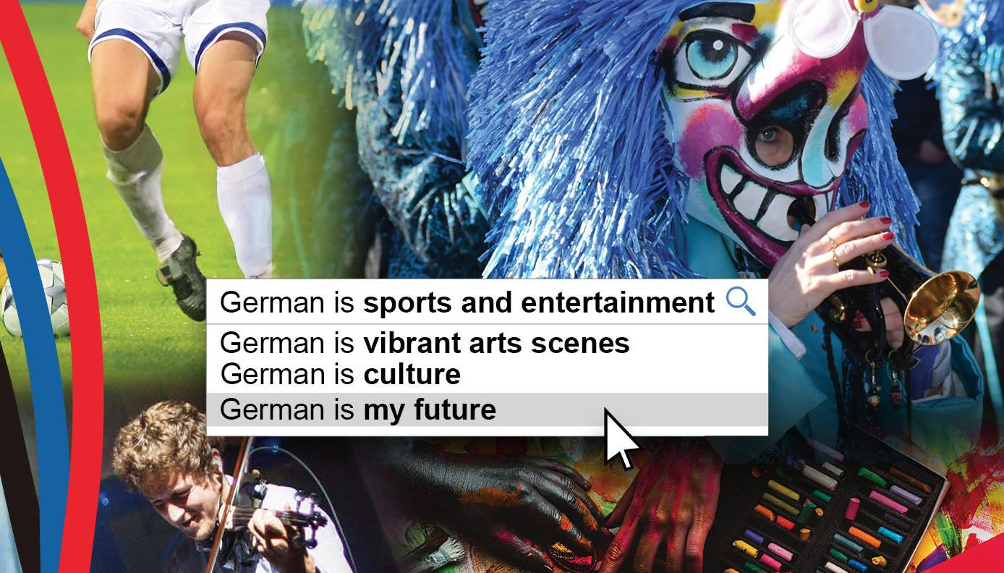
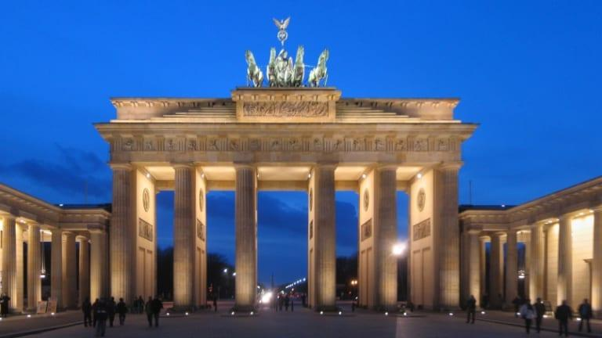
The Culture
Food
  The Swiss, Austrians and Germans are the top chocolate consumers in the world.
  Germany’s most popular street food is not a Bratwurst, it’s a Doner Kebab created by Turkish immigrants.
  Sauerkraut is a well-known “superfood” recommended in a healthy diet.
History
  Germany has some of Europe’s most popular tourist destinations, including the Brandenburg Gate and Berlin Wall.
Festivals
  There are almost 1000 folk festivals in Germany every year with more than 230 million visitors. Oktoberfest in Munich is one of most well-known - but there’s also Karneval and the festive Christmas Markets in almost every city.
Regions
  Germany is not the only country that uses the German language. Belgium, Switzerland, Luxembourg, and Austria do, too!
Click Here to Return to Main Menu!
Notes:
Promo Picture- https://www.aatg.org/page/GermanIsMyFuture
Brandenburg Gate- https://www.history.com/news/brandenburg-gate-a-brief-history

Slide 5
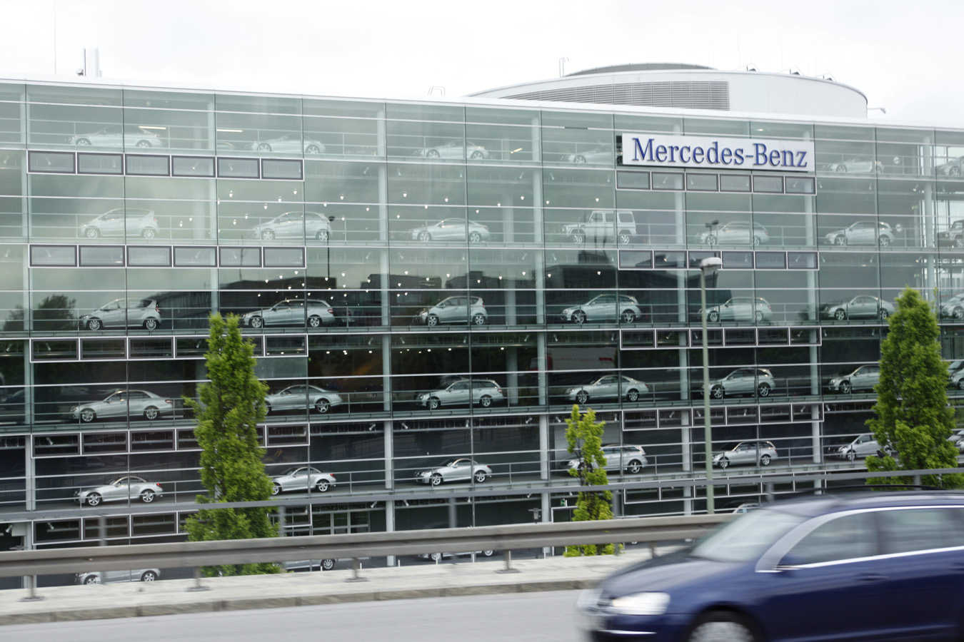
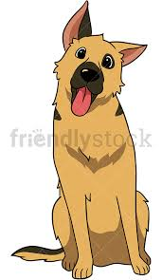
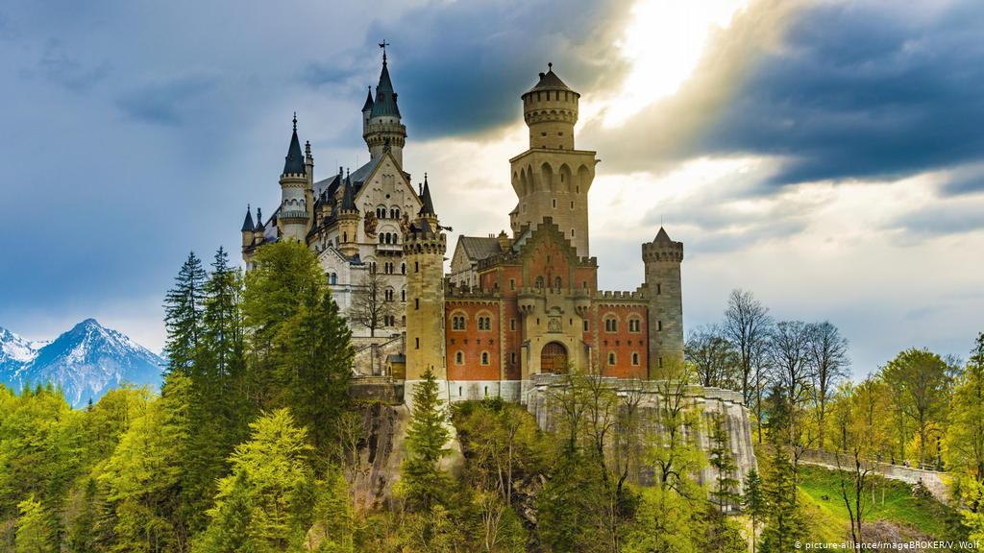
Myths and Facts
German and English words are very similar, these are called cognates. Ex. Hund vs Hound, Couch vs Couch, Hallo vs Hello
Studying German allows you study at prestigious schools or secure valuable fellowships in competitive fields.
German auto, engineering, and technology industries are among the most famous in the world!
Did you know? Neuschwanstein castle inspired Walt Disney!
There are around 20,000 castles in Germany alone.
Click Here to Return to
Main Menu!
Notes:
Neu Castle- https://www.dw.com/en/unbroken-enchantment-neuschwanstein-castle-turns-150/a-50282160
German Shepherd- https://friendlystock.com/product/curious-german-shepherd-dog/
Mercedes Münich- https://wdanielanderson.wordpress.com/2015/01/06/newest-atl-headquarters-mercedes-benz-usa/

